Slide 1

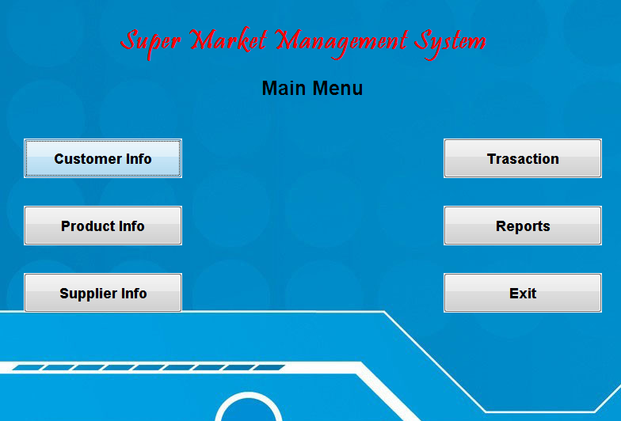

Slide 2


Slide 3
Objective
The main aim and objective of this project is use to manage the details of Shop, Sales, Purchase, Payment, Charges and Stock Management.
Super Shopee is a project based on real Shop, main purpose of creating project is to reduce manual work for managing the Shop, Sales, Purchase, Payment, Charges, Customer details, Supplier details and Stock Management.

Slide 4
Introduction
Every organization, whether big or small, has challenges to overcome and managing the information of Customer, Supplier, Sales, Purchase, and Payments theregore "Super Shopee" has been developed to override the problems prevailing in the practicing manual system. This software is supported to eliminate and in some cases reduce the hardships faced by this existing system. Moreover this system is designed for the particular need of the company to carry out operations in a smooth and effective manner.
The application is reduced as much as possible to avoid errors while entering the data. It also provides error message while entering invalid data. No formal knowledge is needed for the user to use this system. It can lead to error free, secure, reliable and fast management system. It can assist the user to concentrate on their other activities rather to concentrate on the record keeping. Thus it will help organization in better utilization of resources.

Slide 5
Project Description
The Objective of this project is to develop a system that automates the process of maintaining sale, purchase, stock, customer and supplier details. The purpose is to design a system using which one can perform all operations related to shop.
This System maintains & controls the database of customer and supplier information.
The system mainly organizes the shop information. The main purpose behind to make this system for effective & efficient work. To make the security system computerizes & maintains the records.

Slide 6
Existing System
The existing system is maintained by manually, which in turn caused dependency between colleagues.
It is not easy to keep the all information about the shop manually, because procedure is very and theoretical.
Sometimes information may get lost because of its writing in the books and register.
It also led to loss of time & energy.
The records or transaction are not to be properly maintained.
The process of purchase, billing and selling is lengthy. Difficult to maintain the customer details of package and payment receipt in register.
It consist lot of paper work, which was difficult to manage.

Slide 7
Proposed System
It is utilize the accuracy of work.
Proper maintenance of information about the shop.
It also provides the service like selling, purchasing, billing, saving of data.
It is very easy to insert, update, delete, modify & retrieve data from the database.
It reduces the redundancy & duplication of information about the stock.
The system had to eradicate all the disadvantage of the old system and prove its superiority.
New system has ability to get things done at very rapid rate.
The system stress information and provides it when actually needed.
The system is accurate in calculation of a very accurate manner.
It can’t be access unauthorized person because it’s security.

Slide 8
Scope of the system
To utilize resources in an efficient manner by increasing their productivity through automation.
The system generates types of information that can be used for various purposes.
It satisfies the user requirement.
Be easy to understand by the user and operator.
Be easy to operate.
Has a good user interface.
Be expandable.
Delivered on schedule within the budget.

Slide 9
Data dictionary

Slide 10
Supplier
Name | Data Type | Constrain | Description
sno | number | Not null | Store supplier no
sname | number |  | Store supplier name
saddr | text |  | Store supplier address
sphone | text |  | Store supplier phone
Product
Name | Data Type | Constrain | Description
pno | number | Not null | Store product number
pname | Text |  | Store product name
pdesc | Text |  | Store product description
pqty | number |  | Store quantity of product
prate | number |  | Store price of product
Customer
Name | Data Type | Constrain | Description
cno | number | Not null | Store customer number
cname | Text |  | Store customer name
caddr | Text |  | Store customer address
cpnone | Text |  | Store customer phone

Slide 11
Purchase
Name | Data Type | Constrain | Description
trans_no | number | Not null | Store name
Sno | number | Not null | Store age
Sname | text |  | Store gender
Billno | number |  | Store email id
Date | text |  | Store phone number
ino1 | number |  | Store item no
iname1 | text |  | Store item name
iqty1 | number |  | Store item quantity
irt1 | number |  | Store item rate
iramt1 | number |  | Store item amount
ino2 | number |  | Store item no
iname2 | text |  | Store item name
iqty2 | number |  | Store item quantity
irt2 | number |  | Store item rate
iramt2 | number |  | Store item amount

Slide 12
Sales
Name | Data Type | Constrain | Description
billno | number | Not null | Store name
cno | number | Not null | Store age
cname | text |  | Store gender
date | text |  | Store phone number
ino1 | number |  | Store item no
iname1 | text |  | Store item name
iqty1 | number |  | Store item quantity
irt1 | number |  | Store item rate
iramt1 | number |  | Store item amount
ino2 | number |  | Store item no
iname2 | text |  | Store item name
iqty2 | number |  | Store item quantity
irt2 | number |  | Store item rate
iramt2 | number |  | Store item amount

Slide 13
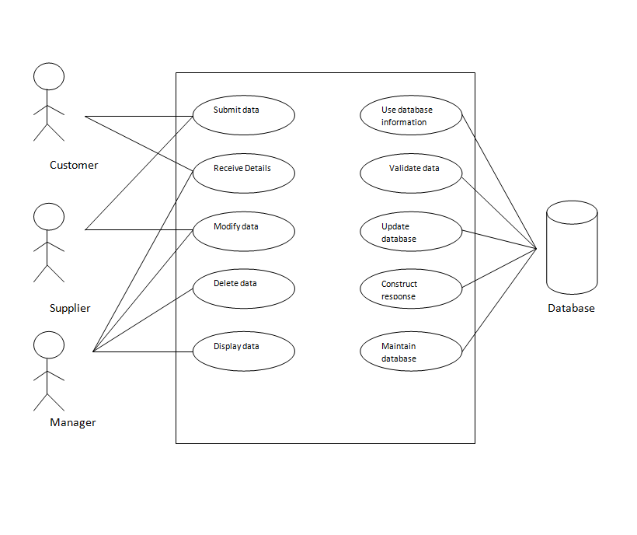
Use Case Diagram

Slide 14
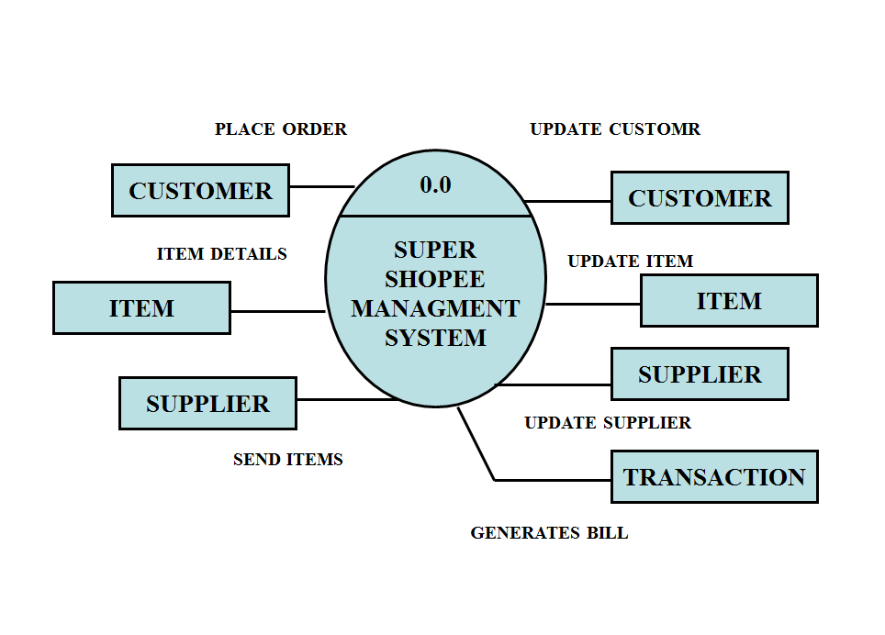
ER Diagram
Zero Level DFD

Slide 15
First Level DFD

Slide 16
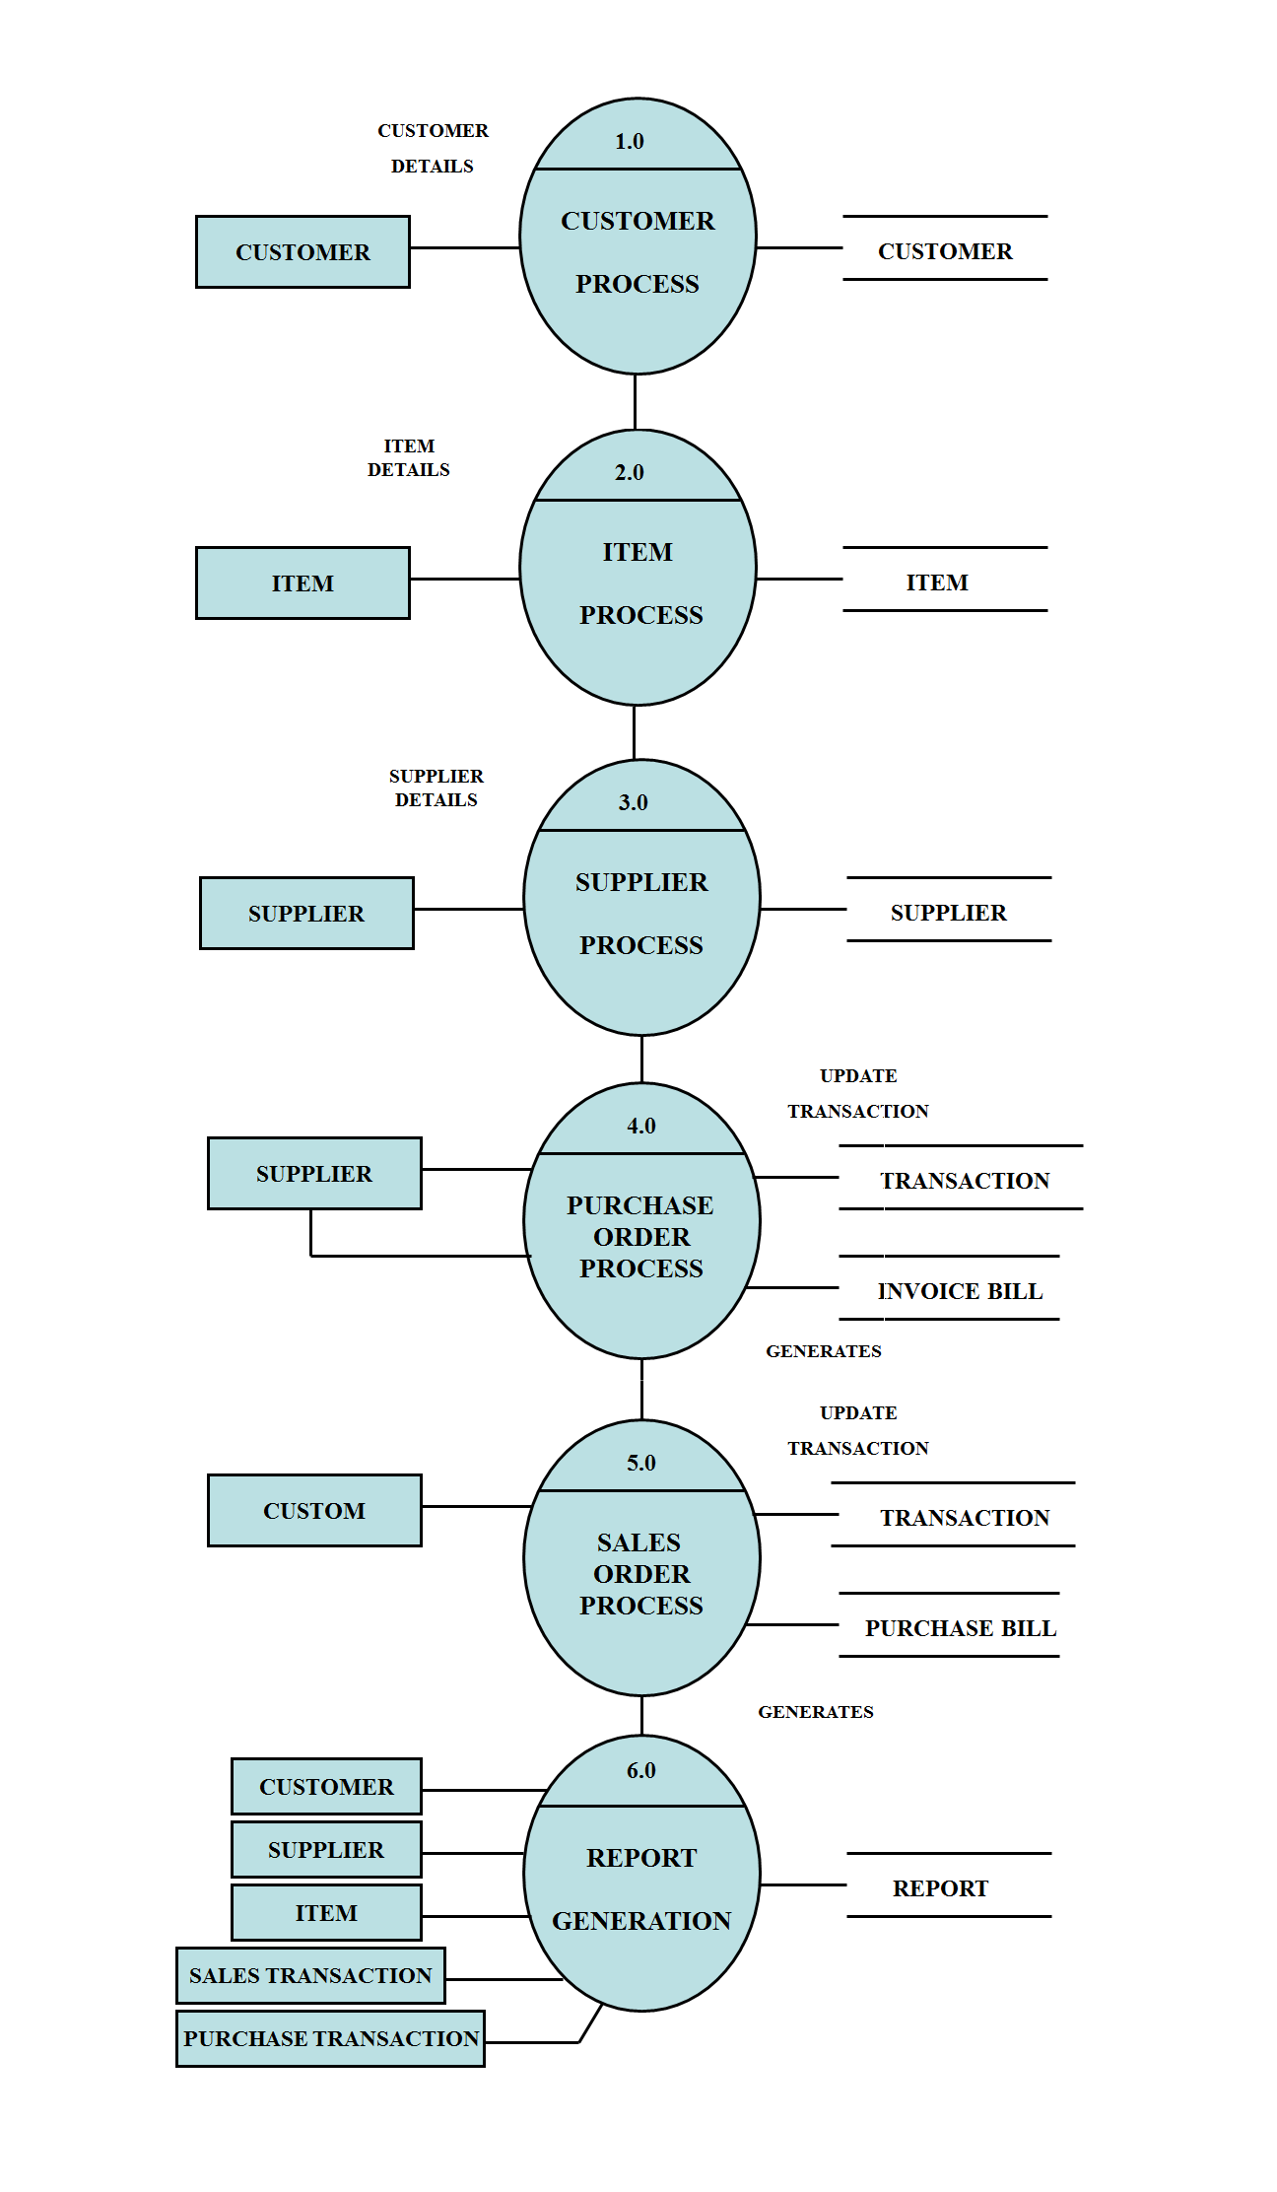

Slide 17
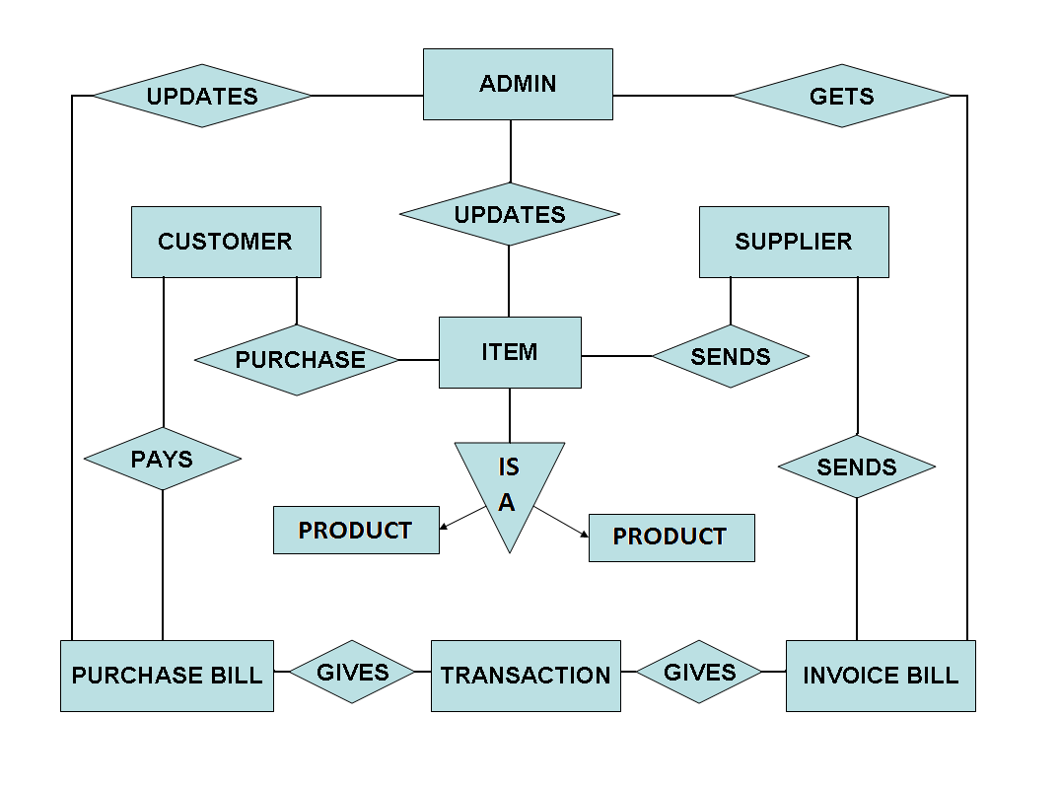
ER Diagram

Slide 18
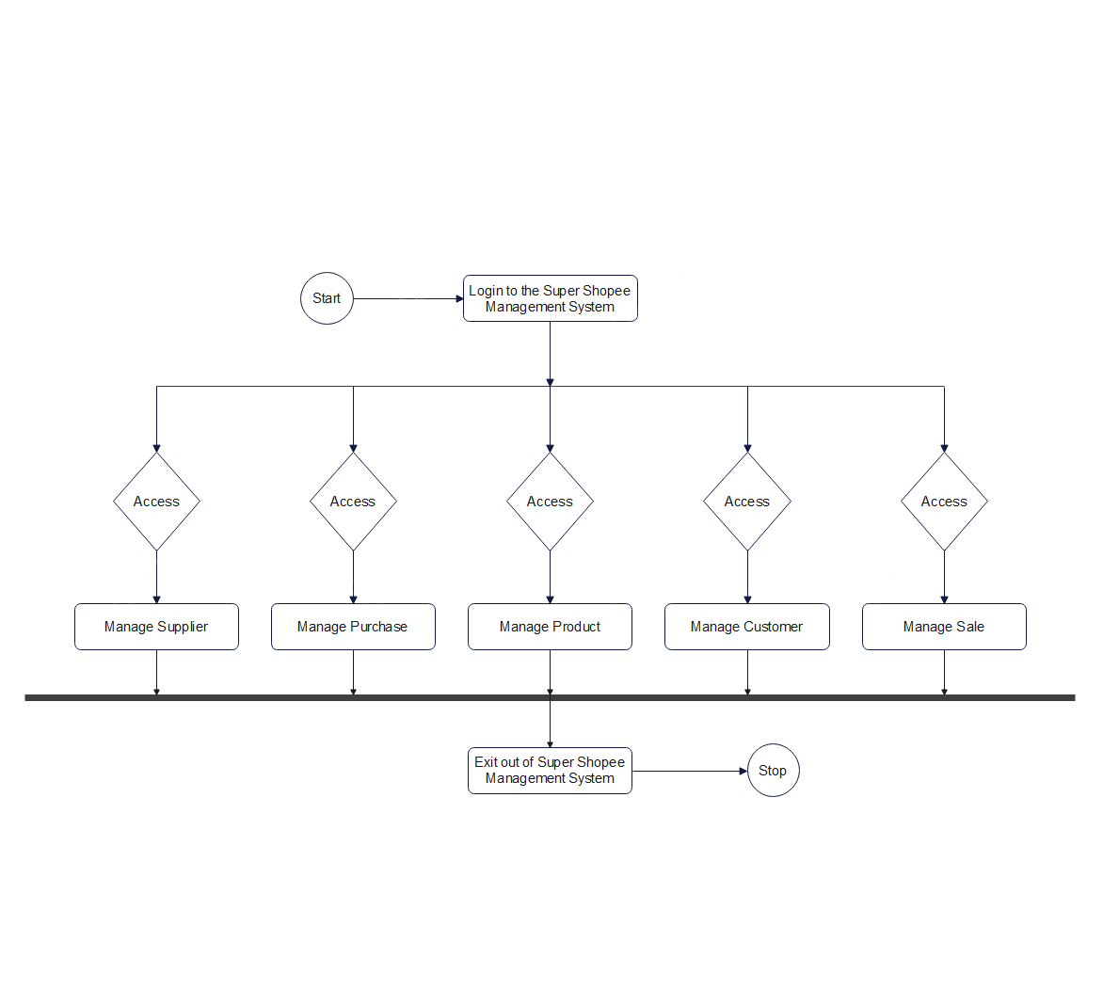
Activity Diagram

Slide 19
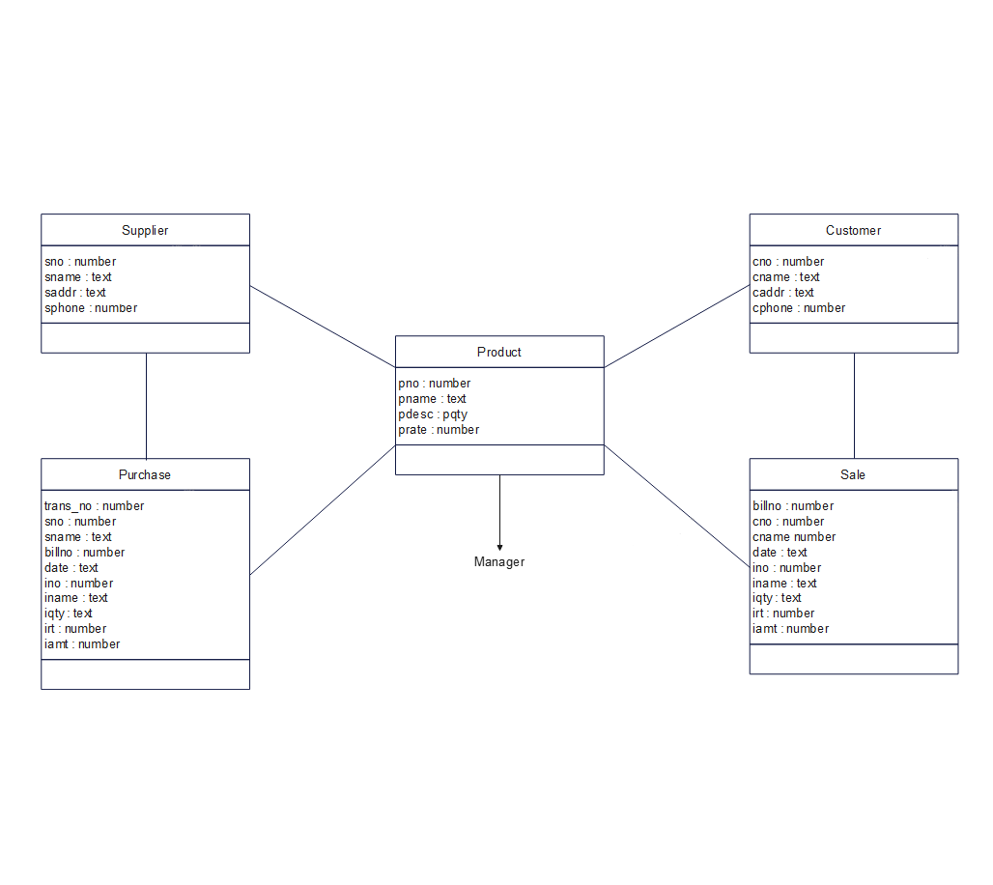
ClassDiagram

Slide 20
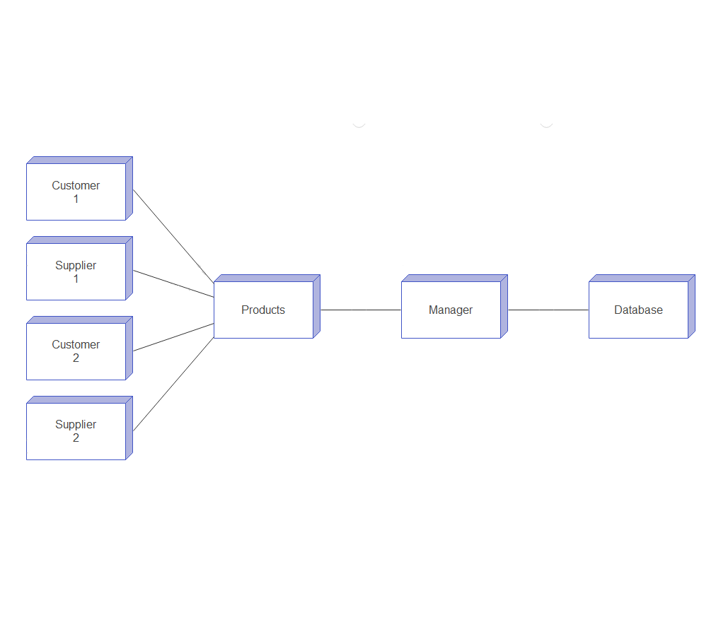
Deployment Diagram

Slide 21
Conclusion
In this project we study the shop management system. It is developed in Java and the database has been built in Microsoft Access only, keeping in mind the specifications of the system, Apart from MS-Access the organization have also implemented other database software like Oracle or SQL. For elaborating the system we have used simple data flow diagrams.
Overall the project teaches us the essential skills like:
Using system analysis and design techniques like data flow diagram in designing the system.
Understanding programming logic and language along with utilities like reports, forms, queries etc. in Eclipse, Jcreator and PL/SQL.

Slide 22
Limitation
The limitations of the shop management system is not knowing an exact stock count in the middle of the period and running the risk of stock outs.
With the shop management system, the company knows the stock level with certainty only when it physically counts the inventory at the end of each shop.
Throughout the period, the company takes customer orders without knowing the exact inventory count or whether enough products are available to meet customer demand.
The limitations of a shop management system include a false sense of reliability and dependence on human entry.
Although a shop management system updates each time a transaction enters the system, it might lack information regarding stolen, damaged or scrapped units.
The company remains unaware of the theft or waste, known as shrinkage, until it performs a physical count at least once per year.

Slide 23
Future Enhancement
System will provide facility of paying online and credit card.
System will provide facility of generating order acceptance note.
System will be still more user friendly & easy to use.

Slide 24
Software Requirements
Operating System:
Windows XP, Windows7, Windows8, Windows10, Windows11.
Language:
Java
Database:
Microsoft Access
Software Development Kit:
Notepad, Notepad++, Sublime Text, Visual Studio, CMD, JDK, Jcreator Pro or Eclipse.

Slide 25
Hardware Requirements
Hardware :
>= Processor Pentium III 630MHz
RAM :
>= 512 MB
Hard disk :
>= 50 GB
Monitor :
Color monitor
Keyboard :
122 key
Mouse :
Wired or Wireless

Slide 26
Bibliography
Book Reference :
Core Java and Adv. Java
DBMS
Software Engineering
Website Reference :
www.google.com
www.youtube.com
www.w3schools.com
www.geeksforgeeks.com
Software Reference:
Notepad ++
JDK
Jcreator Pro, Eclipse
CMD

Slide 27


